Slide 1
Activating teaching: Team Based Learning (ITI, CAE)
Lektor Camilla Fogh Larsen
Notes:
My name is Camilla Fogh and I am teaching bacherlor students in CAE = civil and architectural engineering.
Today I am telling you about my teaching practice with the use of Team Based Learning.
Max 15 min.

Slide 2
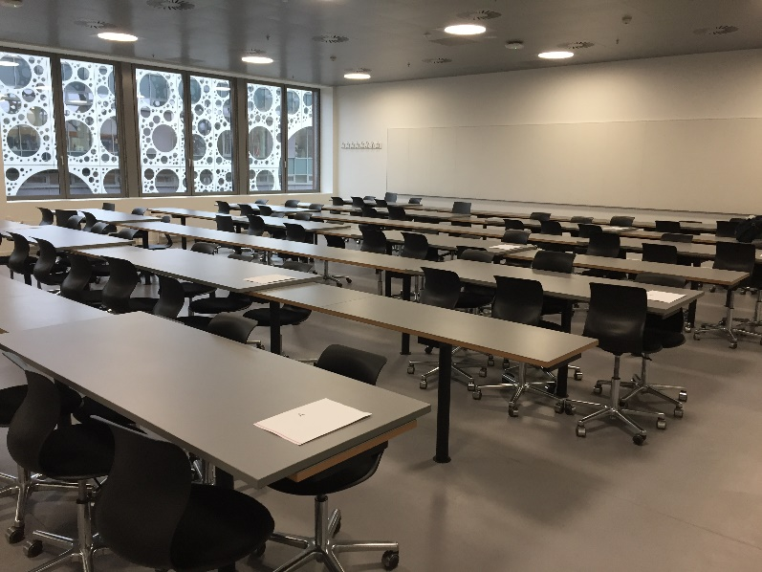
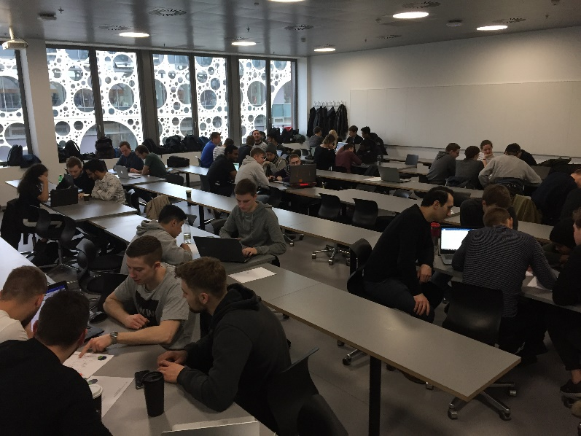
Context: 4. th semester 70 students Roadway design and planning 12 lessons (3,5 hours) Assignment: Project in groups of 4 and oral exam Mandatory course (language Danish) Classroom U180 I need to make group-tables before every lesson…
2
Notes:
In this example from this spring I am teaching 70 students on 4. th semester in roadway design and planning in non-urban areas.
The goal is to calculate the paving and make drawings of the roadway design in a 3D-program. Lastly to plan the constructionwork and calculate the need of materials and machines and calculate the price of the project. They are working in groups of 4 people with this project.
I have 12 lessons. 3,5 hours each time. The teaching language is Danish.

Slide 3
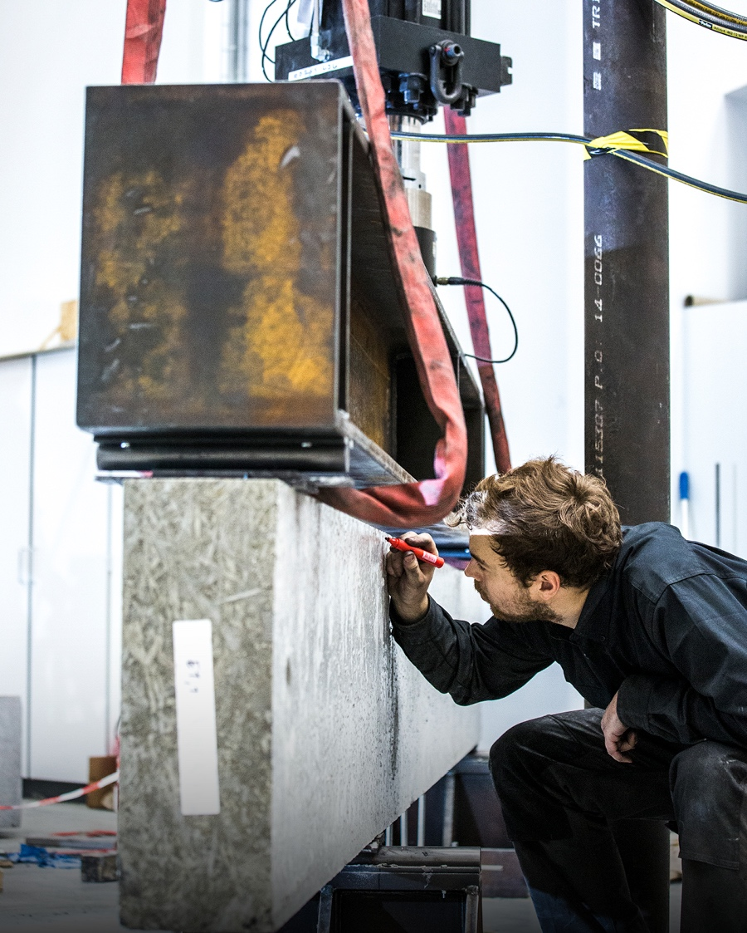
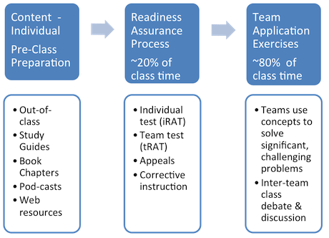
Activating teaching
Intention: To give the students an opportunity to reflect and apply their knowledge.
Challenge: The students need to interact with the subject (read, write, speak, discuss and solve problems – so more than just listening). It can be difficult to activate all students at the same time and getting all the students to express themselves at the same time in large classrooms.
Solution by use of Team Based Learning (TBL):

Slide 4
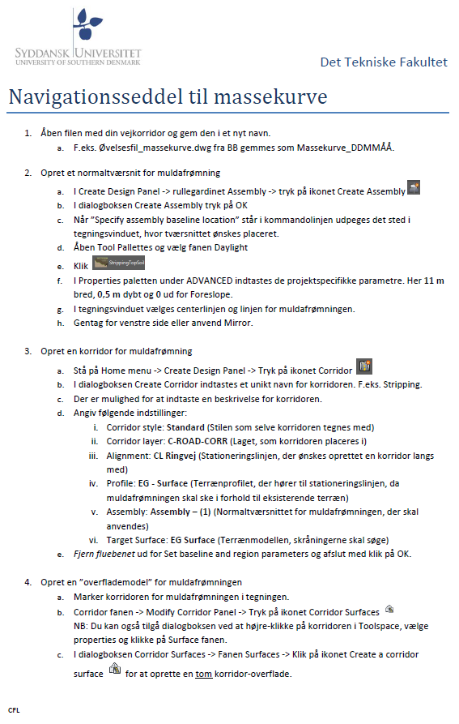
Pre-Class preparation (Individual)
Number
Subject
Study guides: book chapters, web resources, video lecture and small exercise
Lecture plan
Video lecture is recorded with Kaltura and uploaded directly to the Blackboard course.
4

Slide 5
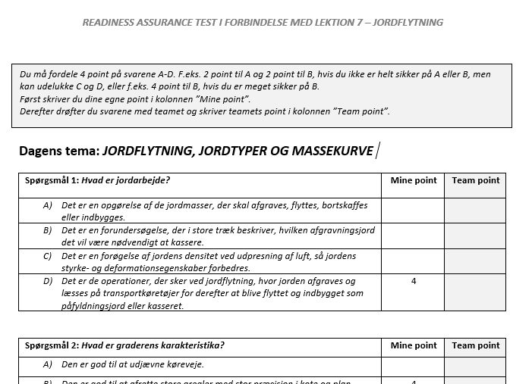
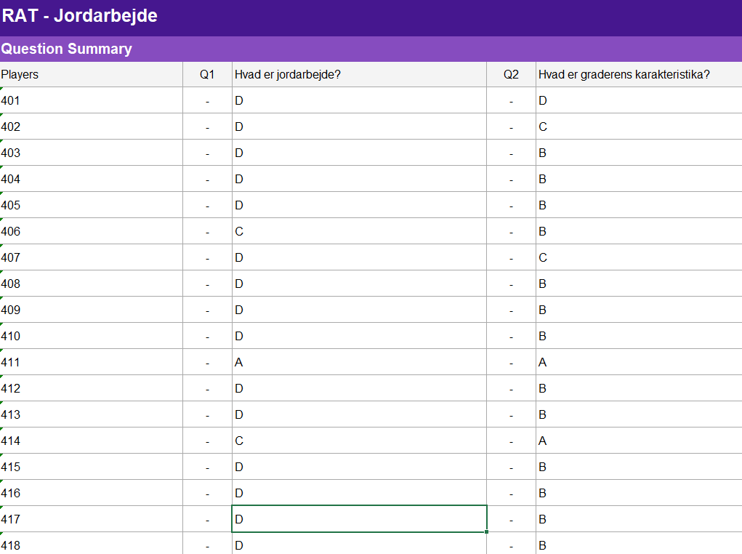
Readiness Assurance Process (~20% of class time)
Individual test (iRAT) and Team test (tRAT)
Same questions handed out on paper.
First individual reply then discussion with group members for group reply.
Effect: First the students are forced to be prepared. Second the students need to interact with the subject. They need to read, write, speak and discuss with technical terms in the group. Many students can talk at the same time even in large classes.
Simultaneous report
Teams should easily be able to display their answer at the same time so that all teams can see it.
I am using Kahoot.com -> Surveys
Effect: Each group can explain and defend their decision. I choose a person to talk so it is not the same who talks every time.
Notes:
RAT questions:
Significant problem. Students solve problems that are as realistic as possible.
Same problem. Every team works on the same problem at the same time. Ideally, different teams will select different options for answers.
Specific choice. Each team must make a specific choice through their discussion.
Simultaneous report. When it is time for teams to display their specific choices to a particular question, they do so at the same time. This way, everyone gets immediate feedback on where they might stand in the posting and they are then accountable to explain and defend their decision.

Slide 6
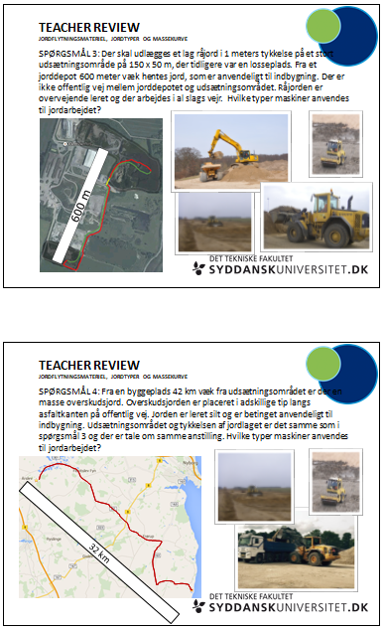
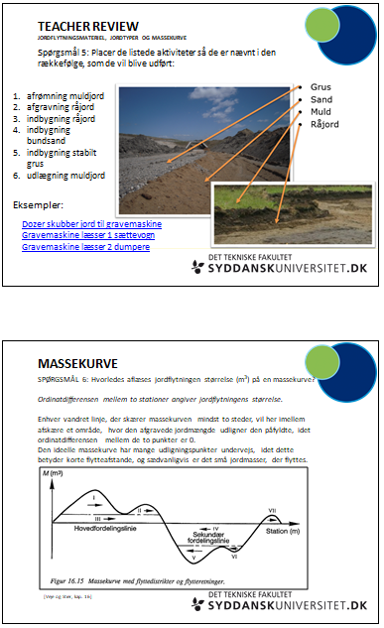
Readiness Assurance Process (~20% of class time)
Corrective instruction
Students are given clarification from the instructor in the concepts they have been struggling with during the tRAT.
I have prepared a power point including all questions even though only a few are used in the class-room.
Notes:
Maybe it is different questions different classes are struggling with next year? And to easy questions are replaced by more difficult ones.

Slide 7
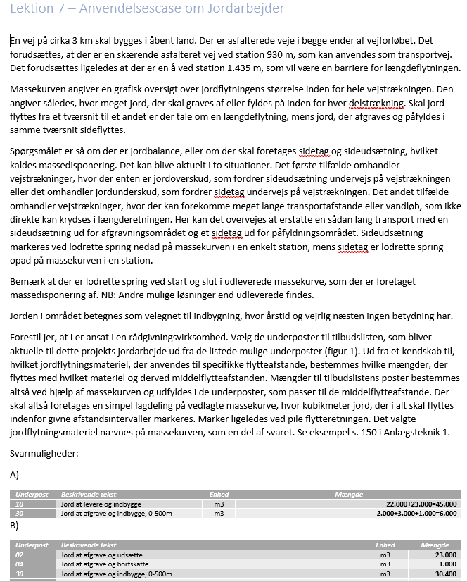
Team Application Exercise (~80% of class time)
This is the most important step!
Students, in teams, are presented with a scenario/vignette that is similar to the type of problem that they will be grappling with in their careers. They are challenged to make interpretations, calculations, predictions and analyses of given information's and make a specific choice from a range of options, post their choice when other teams post theirs, then explain and defend their choice to the class if asked to do so.
My vignette: Make a list of mass volume of soil by using a mass haul diagram
7
7
Notes:
Svarmuligheder: Possible answers

Slide 8
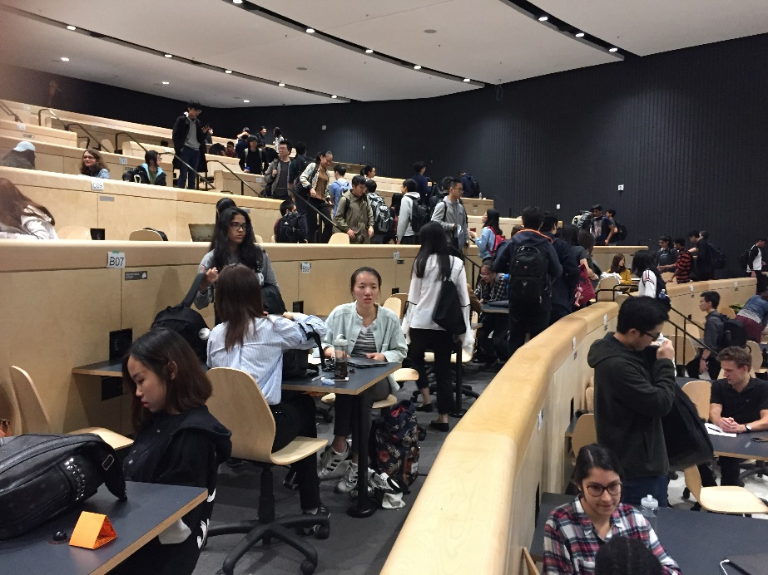
Wishes
More information
8
8
Notes:
Study trip to University of Toronto last autumn. Auditoriums with group tables and monitors and speakers at each table.

